Slide 1

Lecture – 8/30/2016
CSCI 36300 – Software Design

Slide 2
Last Week: Recap
Introduction
Course Outline
Expectations
Git Introduction
IU GitHub
Tutorial
Exercise
Just a little over half the class has completed the tutorial…

Slide 3
C++ Inline Files

Slide 4
C++ Inline Files
Motivation:
Organizational tool for C++ development.
They provide a way to outline your code and separate the interface from the implementation.
Reduces code clutter.
Significant benefits when dealing with large projects and specifically when dealing with many different classes.

Slide 5
C++ Inline Files
Header File:
// ComplexAlgorithm.h
struct Data
{
// Struct defined here…
};
void ComplexAlgorithm( Data* memory );
#include "ComplexAlgorithm.inl"

Slide 6
C++ Inline Files
CPP File:
// ComplexAlgorithm.cpp
#include "ComplexAlgorithm.h"
void SmallerAlgorithmUsedInComplexAlgorithm( Data* memory )
{
// ...
}
void ComplexAlgorithmHelper( Data* memory )
{
// ...
}
void ComplexAlgorithm( Data* memory )
{
// ...
}

Slide 7
C++ Inline Files
INL File:
Can be inline or template functions.
// ComplexAlgorithm.inl
inline void AnotherHelper( )
{
}
inline void YetAnotherHelper( )
{
}

Slide 8
C++ Inline Functions
Optimization technique in order to increase the execution time of a program.
How?
Inline function definitions are replaced at compile time rather than at runtime.
Essentially, we are offloading some of the unnecessary work to allow our program to be more efficient.

Slide 9
C++ Inline Functions
Pros:
It speeds up your program by avoiding function calling overhead.
It save overhead of variables push/pop on the stack, when function calling happens.
It save overhead of return call from a function.
You can put a function definition in a header file.
Cons:
It increases the executable size due to code expansion.
Recompilation needed.
It makes your header file larger.
Increases the executable size.
Embedded systems – where memory is vital.

Slide 10
MPC Introduction

Slide 11
MPC Introduction
MPC was developed to make our lives as developers easier…
It was developed by OCI to assist with maintaining software designed to build on many platforms.
The Makefile, Project, and workspace Creator tool.
This will allow for automatic creation of these essential components of our assignments.
https://www.ociweb.com/products/mpc/

Slide 12
MPC Introduction
What does it do?
Utility that promote portability of projects across different build tools & environments using generic configuration files.
Portability & Extendibility are the keys!
How do we obtain/get MPC?
https://github.com/DOCGroup/MPC
Clone the repository to your Tesla/Pegasus account.

Slide 13
MPC Introduction
There are two types of files that can be used to create the necessary files .mpc and .mwc for your code.
.mpc
This is a project definition file – it contains the “know how” as to the construction of your project.
.mwc
This is a workspace definition file – it contains the “know how” as to how to construct the workspace for your specific project.

Slide 14
MPC Introduction
Lets take a closer look at the project definition file – test.mpc:
// Sample File
project (Test) {
exename = test
Source_Files {
test.cpp
}
Header_Files {
//
}
Inline_Files {
//
}
}

Slide 15
MPC Introduction
Lets take a closer look at the workspace definition file – sample.mwc:
workspace (SingleProjectWorkspace) {
// include only this project
Sample.mpc
// include all projects in directory
./stack
}
workspace (AllFilesWorkspace) {
// recursively include all .mpc files
}
This allows us to specify which projects should be part of a given workspace.

Slide 16
MPC Introduction
How can we execute these files?
Must be run at a command prompt.
Can be run inside of your tesla.cs.iupui.edu account.
It runs a Perl script that interprets your file and produces the desired output.
You need to edit your $PATH in order to realize its full power within your session.
You may also need to grant permissions to access/execute the script.
Example:
Below we specify that we are using a project definition file and that we wish to produce the build type “make” and provide it the file name of our definition file.
[rrybarcz@tesla test]$ mpc.pl -type make Test.mpc
[rrybarcz@tesla test]$ mwc.pl -type make Test.mwc

Slide 17
MPC Introduction
Where can I go to get help?
Myself
TA
Or…
The MPC Documentation!
It provides full documentation regarding the various different commands and formats that can be used to generate the desired output files.
https://github.com/DOCGroup/MPC/tree/master/docs

Slide 18
MPC Introduction
MPC is a powerful tool that will make your life easier – it may take some time to learn and configure properly but the rewards will be substantial.
Note:
Later in the semester we will need to modify the .mpc file to allow for use of the C++11 standard.
This is not required for the first assignment but something you may want to start looking into.

Slide 19
Valgrind Introduction

Slide 20

Valgrind Introduction
Valgrind is an instrumentation framework for building dynamic analysis tools.
This toolset can allow for the ability to automatically detect many memory management and threading bugs, and profile your programs in detail.
We will realize the full power of this tool when we analyze our codes performance.
Start off small and simple.

Slide 21
Valgrind Introduction
What does it do?
It can find the following:
Uses Of Uninitialized Memory
Memory Leaks
Illegal Memory Access
Etc.
Why use Valgrind?
Your program seems to leak memory…
Your program crashes in a seemingly random fashion…
Your program is difficult to trace or non-deterministic in its execution…

Slide 22
Valgrind Introduction
How do we obtain Valgrind?
It is out on Pegasus…or…
You can download the source code from the following URL:
http://valgrind.org/downloads/
What do we do once we have downloaded the file?
I would recommend placing it out in your Tesla directory (similar to MPC) for you to use.
The same process of adding Valgrind to your PATH is necessary (see MPC guide).

Slide 23
Valgrind Introduction
Once you have used the MPC tool to generate your Makefile you can now run make to generate your executable.
Once we have the executable we can run Valgrind to analyze the performance. We can do this through the following command:
[rrybarcz@tesla test]$ valgrind --tool=memcheck --log-file=Valgrind.txt ./Test

Slide 24
Valgrind Introduction
Similar to the MPC tool, Valgrind has many options and subcomponents that make it a very valuable and exciting tool to use!
You can find more about the different options through online documentation:
http://valgrind.org/docs/
We will explore this tool more and more as the semester goes along – please make sure you take some time to play around with this on your own.

Slide 25
C++ Review

Slide 26
Programming Languages
The first step in programming is selecting a language.
Duh! Ryan, I think we already knew that. ☺
How do you select the right language for the job?
You need to know the languages strengths and weaknesses.
Important Keys:
Syntax & Semantics
Language extensibility
Supports exception handling
Built-in abstract data types (ADTs)

Slide 27
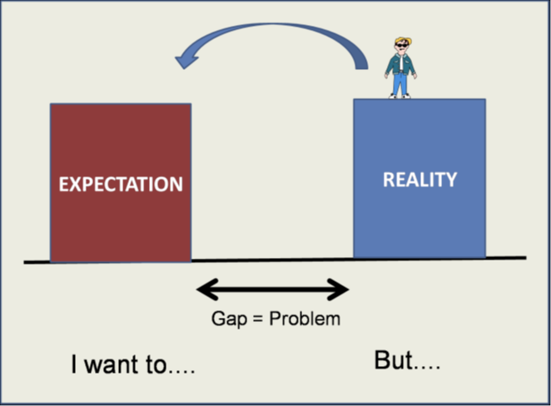
Programming Languages
If we don’t understand the programming language – how do we expect to solve the problem???
“Problem-Implementation” Gap
“We don’t use a sledgehammer to drive a nail.”
Well we can, but it defeats the purpose…

Slide 28

C++ Overview
C++ was developed by Bjarne Stroustrup starting in 1979 at Bell Labs.
C++ is a statically typed and compiled programming language.
Compile time vs. Run time
Supports:
Procedural
Object-Oriented
Generic programming

Slide 29
C++ Review: Pointers
One of the most popular, and powerful, features of the C++ programming language are pointers.
Pointers allow for direct access to the physical memory location.
Example:
int * int_ptr;
Here we are defining the memory location of the variable int_ptr.

Slide 30
C++ Review: Pointers
Pointers can point to local variables or a memory location located on the stack.
This gives us complete control over the access of memory within our program.
Example:
char ch = ‘a’;
char * ch_ptr = &ch;
Here we define a char and assign it a value ’a’, then we assign the memory location value of this variable to a new pointer using the & (address of).

Slide 31
C++ Review: Pointers
Pointers can point to dynamically allocated variables (or memory) on the program heap:
Example:
char * data = new char [10];
Lets take a closer look at the operators that are used with pointers:
*
&

Slide 32
C++ Review: Pointers
& = Address of Operator
This returns the memory address where the pointer is pointing to in memory.
* = Dereference Operator
This returns the value pointed to by the pointer.
When initializing a pointer ALWAYS initialize the pointer to NULL (or a known location) – otherwise you can have negative side effects.
int * ch_ptr = 0;

Slide 33
C++ Review: Pointers
A pointer can be reference any memory location, but its your job to make sure the pointer is not referencing an invalid memory location.
Dangling Pointer Problem
Arithmetic Operations
+, +=, -, -=
Example:
const char * name = “Rybarczyk”;
const char * ch_ptr = name;
ch_ptr += 5;
char the_ch = *ch_ptr; // equals ‘c’

Slide 34
C++ Review: Pointers
Dangers of Pointer Arithmetic:
What happens if we try to reference a position outside the range of values?
Using the previous example, what happens if I said +=20 instead?
We, as the programmer, must ensure that checks are made to make sure that this does not occur within our code.

Slide 35
C++ Review: Pointers
Memory Management:
Two Operators:
new()
delete()
In most OO languages we are used to seeing/using the new operator but less acquainted with the delete (automatic garbage collection).

Slide 36
C++ Review: Pointers
Memory Management
// allocate new int and set to 50
int * int_ptr = new int;
*int_ptr = 50;
// delete the pointer
delete int_ptr;
int_ptr = 0; // make sure to set to NULL

Slide 37
C++ Review: Pointers
Lets look at arrays using pointers:
If you know the size of your array you can use the static approach:
char array[5]; // array of size 5
Often, however, we do not know the size of the array at development time. In that case we need a more dynamic approach using the heap:
int * grades = new int [N];

